Slide 1
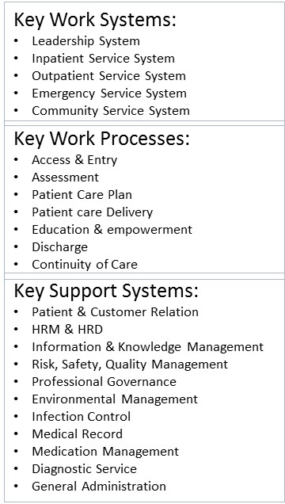
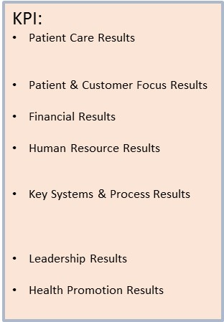
Social Change
Technological Change
Environmental Change
Economic Change
Political Change
Strategic Opportunity:
Strategic Advantage:
Strategic Challenge:
Health Problem:
Strategic Objectives:
Vision:
Mission:
Values:
Service:
Regulation:
Core Competency
External Process
Staff:
Customer/SH &
Requirements:
Facility:
Technology & Equipment:
Material:
Supplier/Partner
Input
Process
Outcome
Customer/Stakeholder

